Slide 1

Dynamic Programming

Slide 2
Algorithmic Paradigms
Greedy: Build up a solution incrementally.
Divide-and-conquer: Break up a problem into two sub-problems, solve each sub-problem independently, and combine solution to sub-problems to form solution to original problem.
Dynamic programming: Break up a problem into a series of overlapping sub-problems, and build up solutions to larger and larger sub-problems.
Main idea of DP:
set up a recurrence relating a solution to a larger instance to solutions of some smaller instances.
-solve smaller instances once
record solutions in a table
extract solution to the initial instance from that table

Slide 3
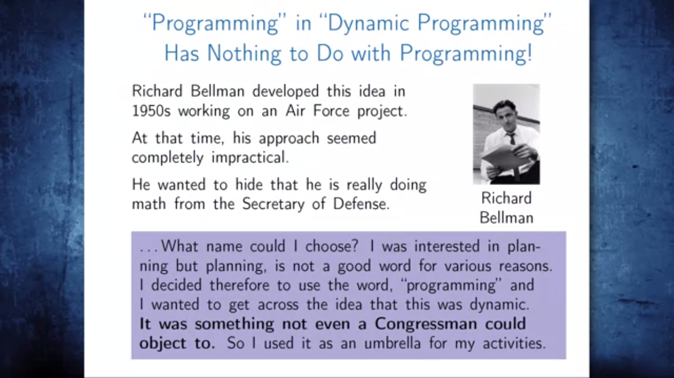

Slide 4
Introduction
Dynamic Programming is an algorithm design technique for optimization problems: often minimizing or maximizing.
Like divide and conquer, DP solves problems by combining solutions to subproblems.
Unlike divide and conquer, subproblems are not independent.
Subproblems may share subsubproblems,
However, solution to one subproblem may not affect the solutions to other subproblems of the same problem.
Only problems that satisfy the principle of optimality are suitable for dynamic programming solutions
Invented by American mathematician Richard Bellman in the 1950s to solve optimization problems and later assimilated by CS
“Programming” here means “planning”
Key: determine structure of optimal solutions

Slide 5
Dynamic Programming
The term Dynamic Programming comes from Control Theory, not computer science. Programming refers to the use of tables (arrays) to construct a solution.
In dynamic programming we usually reduce time by increasing the amount of space
We solve the problem by solving sub-problems of increasing size and saving each optimal solution in a table (usually).
The table is then used for finding the optimal solution to larger problems.
Time is saved since each sub-problem is solved only once.
The principle of optimality applies if the optimal solution to a problem always contains optimal solutions to all subproblems.
Elements of Dynamic Programming:
Optimal substructure
Overlapping subproblems

Slide 6
Examples of DP algorithms
Computing a binomial coefficient
Longest common subsequence
Making Change Problem
Floyd’s algorithm for all-pairs shortest paths
Constructing an optimal binary search tree
Some instances of difficult discrete optimization problems:
- traveling salesman
- knapsack

Slide 7
Steps in Dynamic Programming
Characterize structure of an optimal solution.
Define value of optimal solution recursively.
Compute optimal solution values either top-down with caching or bottom-up in a table.
Construct an optimal solution from computed values.
We’ll study these with the help of examples.

Slide 8
Example – Fibonacci Numbers using Dynamic programming
Fibonacci sequence: 0 , 1 , 1 , 2 , 3 , 5 , 8 , 13 , 21 , …
Dynamic programming calculates from bottom to top.
Values are stored for later use.
This reduces repetitive calculation.

Slide 9
Fibonacci Numbers: Top-down approach
int Fib(int n)
{ if (n <= 1) return 1; else return Fib(n - 1) + Fib(n - 2); }
Computing the n^{th} Fibonacci number recursively:
F(n) = F(n-1) + F(n-2)
F(0) = 0
F(1) = 1
F(n)
F(n-1) + F(n-2)
F(n-2) + F(n-3) F(n-3) + F(n-4)
What is the Recurrence relationship?
T(n) = T(n-1) + T(n-2) + 1
What is the solution to this?
Clearly it is O(2^{n}).
You should notice that T(n) grows very similarly to F(n), so in fact T(n) = Θ(F(n)).

Slide 10
Fibonacci Numbers: Solved by a recursive program
Why is the top-down so inefficient?
- Recomputes many sub-problems.
It should be solved by a simple loop.
Fib(5) +
Fib(4) +
Fib(3) +
Fib(3) +
Fib(2) +
Fib(2) +
Fib(1)
Fib(2) +
Fib(1)
Fib(1)
Fib(0)
Fib(1)
Fib(0)
Fib(1)
Fib(0)
Much replicated computation is done

Slide 11
Fibonacci Numbers: Bottom-up approach
Computing the n^{th} Fibonacci number using a :
F(0) = 0
F(1) = 1
F(2) = 1+0 = 1
…
F(n-1) = F(n-2) + F(n-3)
F(n) = F(n-1) + F(n-2)
Efficiency:
Time – O(n)
Space – O(n)

Slide 12
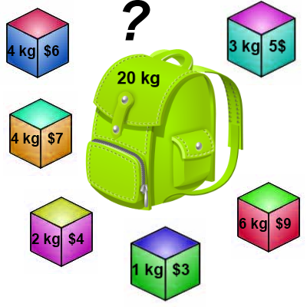
Knapsack problem
There are two versions of the problem:
“0-1 knapsack problem” and
“Fractional knapsack problem”
Items are indivisible: you either take an item or not.
- Can be solved with dynamic programming
Items are divisible: you can take any fraction of an item.
- Solved with a greedy algorithm

Slide 13
0-1 Knapsack
Given some items, pack the knapsack to get the maximum total value. Each item has some weight and some value. Total weight that we can carry is no more than some fixed number W.
In 0-1 Knapsack, items cannot be broken which means the thief should take the item as a whole or should leave it. so we can either take an entire item or reject it completely.
Hence, in case of 0-1 Knapsack, the value of x_{i} can be either 0 or 1, where other constraints remain the same.
n
maximize
p_{i} x_{i}
i = 1
n
subject to
w_{i} x_{i} <= C
i = 1

Slide 14
0-1 Knapsack
So now we must re-work the way we build upon previous sub-problems…
Let B[k, w] represent the maximum total value of a subset Sk with weight w.
Our goal is to find B[n, W], where n is the total number of items and W is the maximal weight the knapsack can carry.
So our recursive formula for subproblems:
B[k, w] = B[k - 1,w], if w_{k} > w
= max { B[k - 1,w], B[k - 1,w - w_{k}] + v_{k}}, otherwise
First case: w_{k} > w
Item k can’t be part of the solution! If it was the total weight would be > w, which is unacceptable.
Second case: w_{k} ≤ w
Then the item k can be in the solution, and we choose the case with greater value.

Slide 15
0-1 Knapsack Algorithm
for w = 0 to W
V[0,w] = 0
for i = 1 to n
V[i,0] = 0
for i = 1 to n
for w = 1 to W
if w_{i} <= w // item i can be part of the solution
if b_{i} + V[i-1,w-w_{i}] > V[i-1,w]
V[i,w] = b_{i} + V[i-1,w- w_{i}]
else
V[i,w] = V[i-1,w]
else V[i,w] = V[i-1,w] // w_{i} > w

Slide 16
Running time
for w = 0 to W
V[0,w] = 0
for i = 1 to n
V[i,0] = 0
for i = 1 to n
for w = 0 to W
< the rest of the code >
O(W)
Repeat n times
O(W)
What is the running time of this algorithm?
O(n*W)

Slide 17
Example
Let’s run our algorithm on the following data:
n = 4 (Number of Items in knapsack)
W = 5 (max weight)
Elements (weight, benefit): (2,3), (3,4), (4,5), (5,6)

Slide 18
Example
i\W
0
1
2
3
4
5
0
0
0
0
0
0
0
1
2
3
4
for w = 0 to W
V[0,w] = 0

Slide 19
Example
i\W
0
1
2
3
4
5
0
0
0
0
0
0
0
1
0
2
0
3
0
4
0
for i = 1 to n
V[i,0] = 0

Slide 20
Example
Items:
1: (2,3)
2: (3,4)
3: (4,5)
4: (5,6)
i\W
0
1
2
3
4
5
i=1
b_{i}=3
w_{i}=2
w=1
w-w_{i} =-1
0
0
0
0
0
0
0
1
0
0
2
0
3
0
4
0
if w_{i} <= w // item i can be part of the solution
if b_{i} + V[i-1,w-w_{i}] > V[i-1,w]
V[i,w] = b_{i} + V[i-1,w- w_{i}]
else
V[i,w] = V[i-1,w]
else V[i,w] = V[i-1,w] // w_{i} > w

Slide 21
Example
Items:
1: (2,3)
2: (3,4)
3: (4,5)
4: (5,6)
i\W
0
1
2
3
4
5
i=1
b_{i}=3
w_{i}=2
w=2
w-w_{i} =0
0
0
0
0
0
0
0
1
0
0
3
2
0
3
0
4
0
if w_{i} <= w // item i can be part of the solution
if b_{i} + V[i-1,w-w_{i}] > V[i-1,w]
V[i,w] = b_{i} + V[i-1,w- w_{i}]
else
V[i,w] = V[i-1,w]
else V[i,w] = V[i-1,w] // w_{i} > w

Slide 22
Example
Items:
1: (2,3)
2: (3,4)
3: (4,5)
4: (5,6)
i\W
0
1
2
3
4
5
i=1
b_{i}=3
w_{i}=2
w=3
w-w_{i} =1
0
0
0
0
0
0
0
1
0
0
3
3
2
0
3
0
4
0
if w_{i} <= w // item i can be part of the solution
if b_{i} + V[i-1,w-w_{i}] > V[i-1,w]
V[i,w] = b_{i} + V[i-1,w- w_{i}]
else
V[i,w] = V[i-1,w]
else V[i,w] = V[i-1,w] // w_{i} > w

Slide 23
Example
Items:
1: (2,3)
2: (3,4)
3: (4,5)
4: (5,6)
i\W
0
1
2
3
4
5
i=1
b_{i}=3
w_{i}=2
w=4
w-w_{i} =2
0
0
0
0
0
0
0
1
0
0
3
3
3
2
0
3
0
4
0
if w_{i} <= w // item i can be part of the solution
if b_{i} + V[i-1,w-w_{i}] > V[i-1,w]
V[i,w] = b_{i} + V[i-1,w- w_{i}]
else
V[i,w] = V[i-1,w]
else V[i,w] = V[i-1,w] // w_{i} > w

Slide 24
Example
Items:
1: (2,3)
2: (3,4)
3: (4,5)
4: (5,6)
i\W
0
1
2
3
4
5
i=1
b_{i}=3
w_{i}=2
w=5
w-w_{i} =3
0
0
0
0
0
0
0
1
0
0
3
3
3
3
2
0
3
0
4
0
if w_{i} <= w // item i can be part of the solution
if b_{i} + V[i-1,w-w_{i}] > V[i-1,w]
V[i,w] = b_{i} + V[i-1,w- w_{i}]
else
V[i,w] = V[i-1,w]
else V[i,w] = V[i-1,w] // w_{i} > w

Slide 25
Example
Items:
1: (2,3)
2: (3,4)
3: (4,5)
4: (5,6)
i\W
0
1
2
3
4
5
i=2
b_{i}=4
w_{i}=3
w=1
w-w_{i} =-2
0
0
0
0
0
0
0
1
0
0
3
3
3
3
2
0
0
3
0
4
0
if w_{i} <= w // item i can be part of the solution
if b_{i} + V[i-1,w-w_{i}] > V[i-1,w]
V[i,w] = b_{i} + V[i-1,w- w_{i}]
else
V[i,w] = V[i-1,w]
else V[i,w] = V[i-1,w] // w_{i} > w

Slide 26
Example
Items:
1: (2,3)
2: (3,4)
3: (4,5)
4: (5,6)
i\W
0
1
2
3
4
5
i=2
b_{i}=4
w_{i}=3
w=2
w-w_{i} =-1
0
0
0
0
0
0
0
1
0
0
3
3
3
3
2
0
0
3
3
0
4
0
if w_{i} <= w // item i can be part of the solution
if b_{i} + V[i-1,w-w_{i}] > V[i-1,w]
V[i,w] = b_{i} + V[i-1,w- w_{i}]
else
V[i,w] = V[i-1,w]
else V[i,w] = V[i-1,w] // w_{i} > w

Slide 27
Example
Items:
1: (2,3)
2: (3,4)
3: (4,5)
4: (5,6)
i\W
0
1
2
3
4
5
i=2
b_{i}=4
w_{i}=3
w=3
w-w_{i} =0
0
0
0
0
0
0
0
1
0
0
3
3
3
3
2
0
0
3
4
3
0
4
0
if w_{i} <= w // item i can be part of the solution
if b_{i} + V[i-1,w-w_{i}] > V[i-1,w]
V[i,w] = b_{i} + V[i-1,w- w_{i}]
else
V[i,w] = V[i-1,w]
else V[i,w] = V[i-1,w] // w_{i} > w

Slide 28
Example
Items:
1: (2,3)
2: (3,4)
3: (4,5)
4: (5,6)
i\W
0
1
2
3
4
5
i=2
b_{i}=4
w_{i}=3
w=4
w-w_{i} =1
0
0
0
0
0
0
0
1
0
0
3
3
3
3
2
0
0
3
4
4
3
0
4
0
if w_{i} <= w // item i can be part of the solution
if b_{i} + V[i-1,w-w_{i}] > V[i-1,w]
V[i,w] = b_{i} + V[i-1,w- w_{i}]
else
V[i,w] = V[i-1,w]
else V[i,w] = V[i-1,w] // w_{i} > w

Slide 29
Example
Items:
1: (2,3)
2: (3,4)
3: (4,5)
4: (5,6)
i\W
0
1
2
3
4
5
i=2
b_{i}=4
w_{i}=3
w=5
w-w_{i} =2
0
0
0
0
0
0
0
1
0
0
3
3
3
3
2
0
0
3
4
4
7
3
0
4
0
if w_{i} <= w // item i can be part of the solution
if b_{i} + V[i-1,w-w_{i}] > V[i-1,w]
V[i,w] = b_{i} + V[i-1,w- w_{i}]
else
V[i,w] = V[i-1,w]
else V[i,w] = V[i-1,w] // w_{i} > w

Slide 30
Example
Items:
1: (2,3)
2: (3,4)
3: (4,5)
4: (5,6)
i\W
0
1
2
3
4
5
i=3
b_{i}=5
w_{i}=4
w= 1..3
0
0
0
0
0
0
0
1
0
0
3
3
3
3
2
0
0
3
4
4
7
3
0
0
3
4
4
0
if w_{i} <= w // item i can be part of the solution
if b_{i} + V[i-1,w-w_{i}] > V[i-1,w]
V[i,w] = b_{i} + V[i-1,w- w_{i}]
else
V[i,w] = V[i-1,w]
else V[i,w] = V[i-1,w] // w_{i} > w

Slide 31
Example
Items:
1: (2,3)
2: (3,4)
3: (4,5)
4: (5,6)
i\W
0
1
2
3
4
5
i=3
b_{i}=5
w_{i}=4
w= 4
w- w_{i}=0
0
0
0
0
0
0
0
1
0
0
3
3
3
3
2
0
0
3
4
4
7
3
0
0
3
4
5
4
0
if w_{i} <= w // item i can be part of the solution
if b_{i} + V[i-1,w-w_{i}] > V[i-1,w]
V[i,w] = b_{i} + V[i-1,w- w_{i}]
else
V[i,w] = V[i-1,w]
else V[i,w] = V[i-1,w] // w_{i} > w

Slide 32
Example
Items:
1: (2,3)
2: (3,4)
3: (4,5)
4: (5,6)
i\W
0
1
2
3
4
5
i=3
b_{i}=5
w_{i}=4
w= 5
w- w_{i}=1
0
0
0
0
0
0
0
1
0
0
3
3
3
3
2
0
0
3
4
4
7
3
0
0
3
4
5
7
4
0
if w_{i} <= w // item i can be part of the solution
if b_{i} + V[i-1,w-w_{i}] > V[i-1,w]
V[i,w] = b_{i} + V[i-1,w- w_{i}]
else
V[i,w] = V[i-1,w]
else V[i,w] = V[i-1,w] // w_{i} > w

Slide 33
Example
Items:
1: (2,3)
2: (3,4)
3: (4,5)
4: (5,6)
i\W
0
1
2
3
4
5
i=4
b_{i}=6
w_{i}=5
w= 1..4
0
0
0
0
0
0
0
1
0
0
3
3
3
3
2
0
0
3
4
4
7
3
0
0
3
4
5
7
4
0
0
3
4
5
if w_{i} <= w // item i can be part of the solution
if b_{i} + V[i-1,w-w_{i}] > V[i-1,w]
V[i,w] = b_{i} + V[i-1,w- w_{i}]
else
V[i,w] = V[i-1,w]
else V[i,w] = V[i-1,w] // w_{i} > w

Slide 34
Example
Items:
1: (2,3)
2: (3,4)
3: (4,5)
4: (5,6)
i\W
0
1
2
3
4
5
i=4
b_{i}=6
w_{i}=5
w= 5
w- w_{i}=0
0
0
0
0
0
0
0
1
0
0
3
3
3
3
2
0
0
3
4
4
7
3
0
0
3
4
5
7
4
0
0
3
4
5
7
if w_{i} <= w // item i can be part of the solution
if b_{i} + V[i-1,w-w_{i}] > V[i-1,w]
V[i,w] = b_{i} + V[i-1,w- w_{i}]
else
V[i,w] = V[i-1,w]
else V[i,w] = V[i-1,w] // w_{i} > w

Slide 35
How to find actual Knapsack Items
All of the information we need is in the table.
V[n,W] is the maximal value of items that can be placed in the Knapsack.
Let i=n and k=W
if V[i,k] ≠ V[i−1,k] then
mark the i^{th} item as in the knapsack
i = i−1, k = k-w_{i}
else
i = i−1 // Assume the i^{th} item is not in the knapsack

Slide 36
Finding the Items
Items:
1: (2,3)
2: (3,4)
3: (4,5)
4: (5,6)
i\W
0
1
2
3
4
5
i=4
k= 5
b_{i}=6
w_{i}=5
V[i,k] = 7
V[i−1,k] =7
0
0
0
0
0
0
0
1
0
0
3
3
3
3
2
0
0
3
4
4
7
3
0
0
3
4
5
7
4
0
0
3
4
5
7
i=n, k=W
while i,k > 0
if V[i,k] ≠ V[i−1,k] then
mark the i^{th} item as in the knapsack
i = i−1, k = k-w_{i}
else
i = i−1

Slide 37
Finding the Items (2)
Items:
1: (2,3)
2: (3,4)
3: (4,5)
4: (5,6)
i\W
0
1
2
3
4
5
i=4
k= 5
b_{i}=6
w_{i}=5
V[i,k] = 7
V[i−1,k] =7
0
0
0
0
0
0
0
1
0
0
3
3
3
3
2
0
0
3
4
4
7
3
0
0
3
4
5
7
4
0
0
3
4
5
7
i=n, k=W
while i,k > 0
if V[i,k] ≠ V[i−1,k] then
mark the i^{th} item as in the knapsack
i = i−1, k = k-w_{i}
else
i = i−1

Slide 38
Finding the Items (3)
Items:
1: (2,3)
2: (3,4)
3: (4,5)
4: (5,6)
i\W
0
1
2
3
4
5
i=3
k= 5
b_{i}=5
w_{i}=4
V[i,k] = 7
V[i−1,k] =7
0
0
0
0
0
0
0
1
0
0
3
3
3
3
2
0
0
3
4
4
7
3
0
0
3
4
5
7
4
0
0
3
4
5
7
i=n, k=W
while i,k > 0
if V[i,k] ≠ V[i−1,k] then
mark the i^{th} item as in the knapsack
i = i−1, k = k-w_{i}
else
i = i−1

Slide 39
Finding the Items (4)
Items:
1: (2,3)
2: (3,4)
3: (4,5)
4: (5,6)
i\W
0
1
2
3
4
5
i=2
k= 5
b_{i}=4
w_{i}=3
V[i,k] = 7
V[i−1,k] =3
k − w_{i}=2
0
0
0
0
0
0
0
1
0
0
3
3
3
3
2
0
0
3
4
4
7
7
3
0
0
3
4
5
7
4
0
0
3
4
5
7
i=n, k=W
while i,k > 0
if V[i,k] ≠ V[i−1,k] then
mark the i^{th} item as in the knapsack
i = i−1, k = k-w_{i}
else
i = i−1

Slide 40
Finding the Items (5)
Items:
1: (2,3)
2: (3,4)
3: (4,5)
4: (5,6)
i\W
0
1
2
3
4
5
i=1
k= 2
b_{i}=3
w_{i}=2
V[i,k] = 3
V[i−1,k] =0
k − w_{i}=0
0
0
0
0
0
0
0
1
0
0
3
3
3
3
3
2
0
0
3
4
4
7
3
0
0
3
4
5
7
4
0
0
3
4
5
7
i=n, k=W
while i,k > 0
if V[i,k] ≠ V[i−1,k] then
mark the i^{th} item as in the knapsack
i = i−1, k = k-w_{i}
else
i = i−1

Slide 41
Finding the Items (6)
Items:
1: (2,3)
2: (3,4)
3: (4,5)
4: (5,6)
i\W
0
1
2
3
4
5
i=0
k= 0
0
0
0
0
0
0
0
1
0
0
3
3
3
3
2
0
0
3
4
4
7
3
0
0
3
4
5
7
The optimal knapsack should contain {1, 2}
4
0
0
3
4
5
7
i=n, k=W
while i,k > 0
if V[i,k] ≠ V[i−1,k] then
mark the n^{th} item as in the knapsack
i = i−1, k = k-w_{i}
else
i = i−1

Slide 42
Another Example
ITEM (i) | 1 | 2 | 3 | 4
VALUE (v) | 100 | 20 | 60 | 40
WEIGHT(w) | 3 | 2 | 4 | 1
Capacity of Knapsack = 5
V[i,w] | w = 0 | 1 | 2 | 3 | 4 | 5
i = 0 | 0 | 0 | 0 | 0 | 0 | 0
1 | 0 | 0 | 0 | 100 | 100 | 100
2 | 0 | 0 | 20 | 100 | 100 | 120
3 | 0 | 0 | 20 | 100 | 100 | 120
4 | 0 | 40 | 40 | 100 | 140 | 140

Slide 43
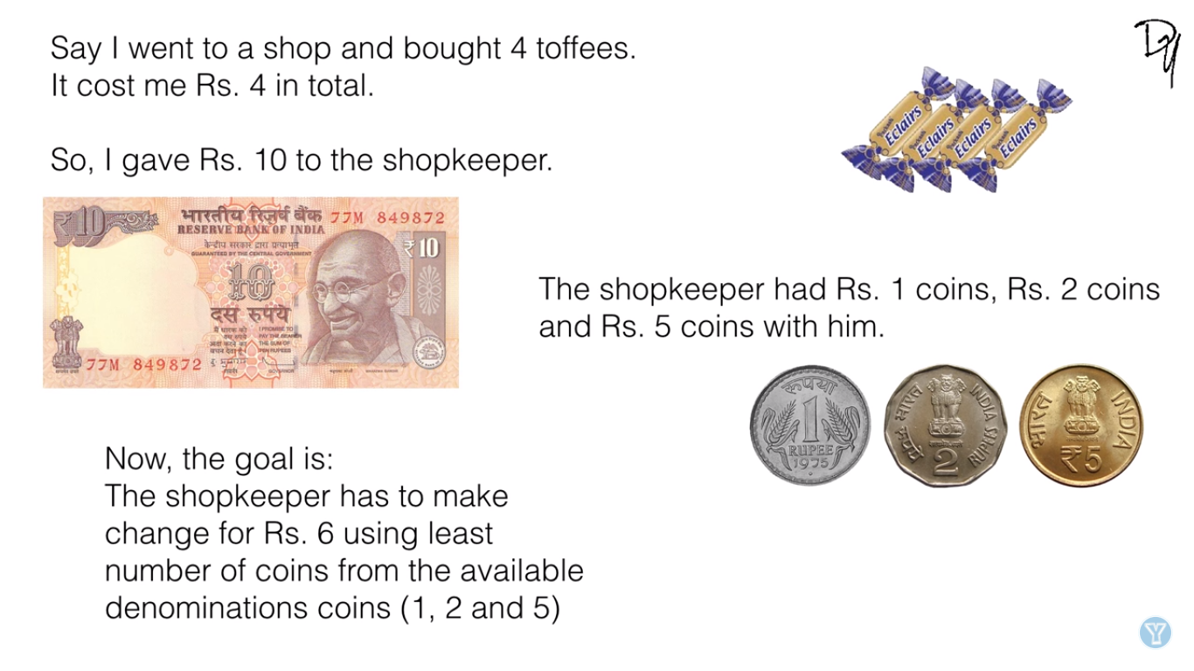
Change-Making Problem

Slide 44
Dynamic Programming Approach
Formula for Filling Table
Example: Given Denominations are {1,4,6} to make change of 9

Slide 45
Dynamic Programming Approach
Solution Table

Slide 46
How to find actual Denominations
Solution: Minimum number of coins required will be 3 which is { 4 (2 Time) & 1 (1Time)}

Slide 47
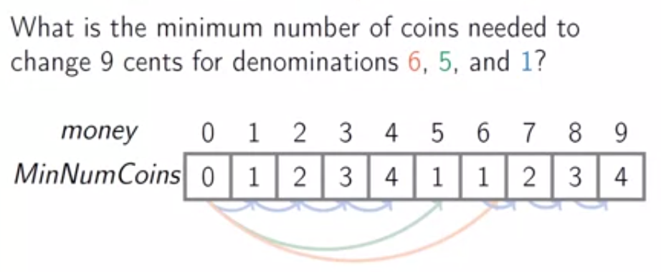
Example
Minimum number of coins required to make change for each money[i]

Slide 48
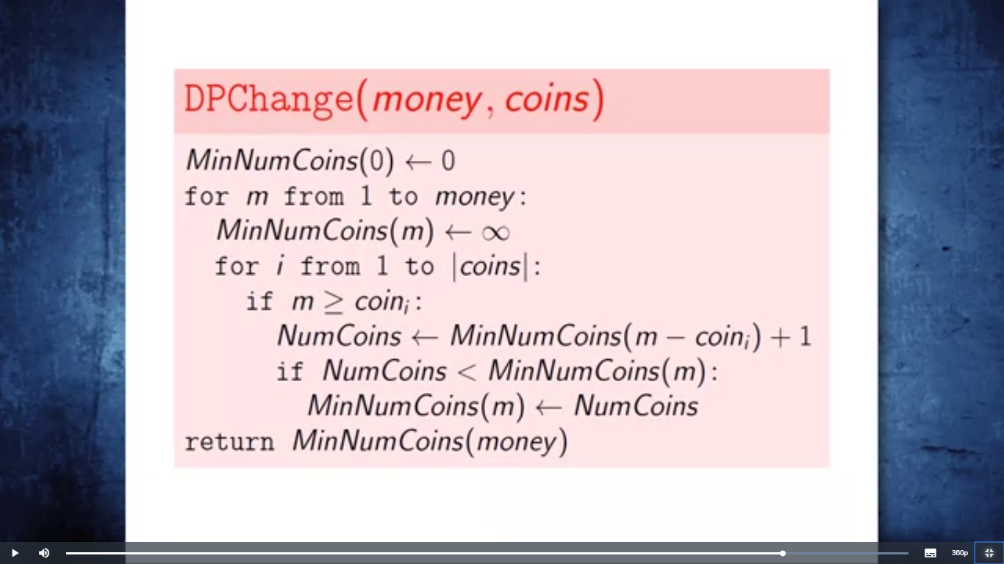
Algorithm

Slide 49
Binomial Coefficients
A binomial coefficient C(n, k) can be defined as the coefficient of X^{k} in the expansion of (1 + X)^{n}.
A binomial coefficient C(n, k) represents the number of k-element subsets (or k-combinations) of an n-element set.
More formally it is ^{n}C _{k} (k objects can be chosen among n objects)
The Problem is to write a function that takes two parameters n and k and returns the value of Binomial Coefficient C(n, k).
For example, your function should return 6 for n = 4 and k = 2, and it should return 10 for n = 5 and k = 2.
Binomial coefficients are coefficients of the binomial formula:
(a + b)^{n} = C(n,0)a^{n}b⁰ + . . . + C(n,k)a^{n-k}b^{k} + . . . + C(n,n)a⁰b^{n}
Recurrence: C(n,k) = C(n-1,k) + C(n-1,k-1) for n > k > 0
C(n,0) = 1, C(n,n) = 1 for n ≥ 0

Slide 50
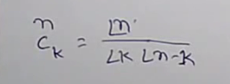
Binomial Coefficients
(x + y)² = x² + 2xy + y², total 3 (or 2+1) coefficients are 1,2,1
(x + y)³ = x³ + 3x²y + 3xy² + y³, coefficients are 1,3,3,1
(x + y)⁴ = x⁴ + 4x³y + 6x²y² + 4xy³ + y⁴, coefficients are 1,4,6,4,1
(x + y)⁵ = x⁵ + 5x⁴y + 10x³y² + 10x²y³ + 5xy⁴ + y⁵, coefficients are 1,5,10,10,5,1
The n+1 coefficients can be computed for (x + y)^{n} according to the formula:
c(n, k) = n! / (k! * (n – k)!) for each of k = 0..n
The repeated computation of all the factorials gets to be expensive.
-Solution to above problem is dynamic programing Approach.

Slide 51
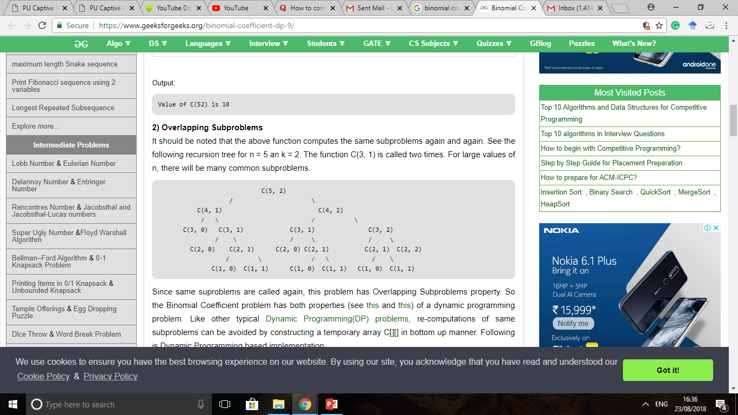
Dynamic Programming Approach
Optimal Substructure
The value of C(n, k) can be recursively calculated using following standard formula for Binomial Coefficients.
C(n, k) = C(n-1, k-1) + C(n-1, k)
C(n, 0) = C(n, n) = 1
2) Overlapping Subproblems
It should be noted that the above function computes the same subproblems again and again. For large values of n, there will be many common subproblems.
Example: Recursion tree for n = 5 an k = 2.
The function C(3, 1) is called two times.

Slide 52
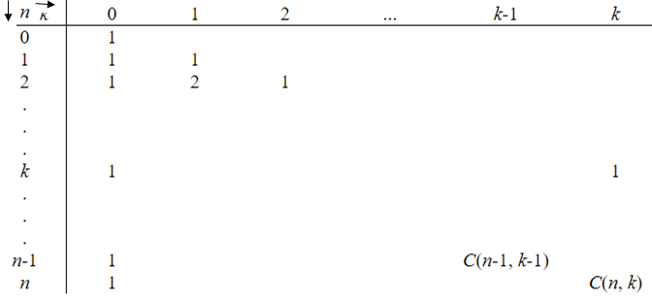
Computing a binomial coefficient by DP
This algorithm is known as Pascal’s Triangle.
Value of C(n,k) can be computed by filling following table where each row depends only on the preceding row.

Slide 53
Computing a binomial coefficient - Example
n c(n,0) c(n,1) c(n,2) c(n,3) c(n,4) c(n,5) c(n,6)
0 1
1 1 1
2 1 2 1
3 1 3 3 1
4 1 4 6 4 1
5 1 5 10 10 5 1
6 1 6 15 20 15 6 1

Slide 54
Computing C(n,k): Algorithm and analysis
Algorithm Binomial(n, k)
for i ← 0 to n do // fill out the table row wise
for i = 0 to min(i, k) do
if j==0 or j==i then C[i, j] ← 1 // Base Condition
else C[i, j] ← C[i-1, j-1] + C[i-1, j] // recursive relation
return C[n, k]
Time efficiency: Θ(nk)
Space efficiency: Θ(nk)

Slide 55
Longest Common Subsequence
Given 2 sequences, X = ⟨x₁,...,x_{m}⟩ and Y = ⟨y₁,...,y_{n}⟩, find a common subsequence whose length is maximum.
Subsequence need not be consecutive, but must be in order.
There are 2^{m} subsequences of X.
Using Simple Brute-force approach, Testing a subsequence (length k) takes time O(k + n).
So brute force algorithm is O(n∗2^{m}).
Example:
president
providence
a l g o r i t h m
a l i g n m e n t
president
providence
Its LCS is “priden”.
One of its LCS is algm.

Slide 56
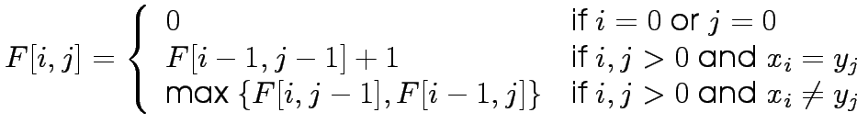
Defining Subproblem
Let Di,j be the length of the LCS of x_{1...i} and y_{1...j}
Find the recurrence
If x_{i} = y_{j} , they both contribute to the LCS.
In this case, D_{i,j} = D_{i−1,j−1} + 1
Either x_{i} or y_{j} does not contribute to the LCS, so one can be dropped. Otherwise, D_{i,j} = max{D_{i−1},_{j} ,D_{i,j−1}}
Find and solve the base cases: D_{i,0} = D_{0,j} = 0
Let F[i,j] denote the length of the longest common subsequence of the first i elements of A and the first j elements of B. The objective of the LCS problem is to find F[n,m].
Recurrence Relation can be written as:

Slide 57
Solving LCSS using Dynamic programming
Given two Sequence
A = b a c a d,
B = a c c b a d c b
Now Create a matrix of size (m+1) x n+1), Where m is size of A, & n is size of B.
we can trace back to find the longest common subsequence of A and B which is {a c a d}.
The last entry in the matrix shows the LCSS.

Slide 58
An LCS Algorithm
Algorithm LCS(X,Y)
Input: Strings X and Y with n and m elements, respectively
Output: For i = 0,…,n-1, j = 0,...,m-1, the length L[i, j] of a longest string that is a subsequence of both the string X[0..i] = x₀x₁x₂…x_{i} and the string Y [0.. j] = y₀y₁y₂…y_{j}
for i =1 to n-1 do
L[i,-1] = 0
for j =0 to m-1 do
L[-1,j] = 0
for i =0 to n-1 do
for j =0 to m-1 do
if (x_{i} == y_{j}) then
L[i, j] = L[i-1, j-1] + 1
else
L[i, j] = max{L[i-1, j] , L[i, j-1]}
return array L

Slide 59
LCS Algorithm Analysis
We have two nested loops n
The outer one iterates n times n
The inner one iterates m times n
A constant amount of work is done inside each iteration of the inner loop n
Thus, the total running time is O( nm )

Slide 60
LCS Example
We’ll see how LCS algorithm works on the following example:
X = ABCB
Y = BDCAB
What is the Longest Common Subsequence of X and Y?
LCS(X, Y) = BCB
X = A B C B
Y = B D C A B

Slide 61
LCS Example (0)
ABCB
BDCAB
j 0 1 2 3 4 5
i
Yj
B
D
C
A
B
0
Xi
A
1
2
B
3
C
4
B
X = ABCB; m = |X| = 4
Y = BDCAB; n = |Y| = 5
Allocate array c[5,4]

Slide 62
LCS Example (1)
ABCB
BDCAB
j 0 1 2 3 4 5
i
Yj
B
D
C
A
B
0
Xi
0
0
0
0
0
0
A
1
0
2
B
0
3
C
0
4
B
0
for i = 1 to m c[i,0] = 0
for j = 1 to n c[0,j] = 0

Slide 63
LCS Example (2)
ABCB
BDCAB
j 0 1 2 3 4 5
i
Yj
B
D
C
A
B
0
Xi
0
0
0
0
0
0
A
1
0
0
2
B
0
3
C
0
4
B
0
if ( X_{i} == Y_{j} )
c[i,j] = c[i-1,j-1] + 1
else c[i,j] = max( c[i-1,j], c[i,j-1] )

Slide 64
LCS Example (3)
ABCB
BDCAB
j 0 1 2 3 4 5
i
Yj
B
D
C
A
B
0
Xi
0
0
0
0
0
0
A
1
0
0
0
0
2
B
0
3
C
0
4
B
0
if ( X_{i} == Y_{j} )
c[i,j] = c[i-1,j-1] + 1
else c[i,j] = max( c[i-1,j], c[i,j-1] )

Slide 65
LCS Example (4)
ABCB
BDCAB
j 0 1 2 3 4 5
i
Yj
B
D
C
A
B
0
Xi
0
0
0
0
0
0
A
1
0
0
0
0
1
2
B
0
3
C
0
4
B
0
if ( X_{i} == Y_{j} )
c[i,j] = c[i-1,j-1] + 1
else c[i,j] = max( c[i-1,j], c[i,j-1] )

Slide 66
LCS Example (5)
ABCB
BDCAB
j 0 1 2 3 4 5
i
Yj
B
D
C
A
B
0
Xi
0
0
0
0
0
0
A
1
0
0
0
0
1
1
2
B
0
3
C
0
4
B
0
if ( X_{i} == Y_{j} )
c[i,j] = c[i-1,j-1] + 1
else c[i,j] = max( c[i-1,j], c[i,j-1] )

Slide 67
LCS Example (6)
ABCB
BDCAB
j 0 1 2 3 4 5
i
Yj
B
D
C
A
B
0
Xi
0
0
0
0
0
0
A
1
0
0
0
0
1
1
2
B
0
1
3
C
0
4
B
0
if ( X_{i} == Y_{j} )
c[i,j] = c[i-1,j-1] + 1
else c[i,j] = max( c[i-1,j], c[i,j-1] )

Slide 68
LCS Example (7)
ABCB
BDCAB
j 0 1 2 3 4 5
i
Yj
B
D
C
A
B
0
Xi
0
0
0
0
0
0
A
1
0
0
0
0
1
1
2
B
0
1
1
1
1
3
C
0
4
B
0
if ( X_{i} == Y_{j} )
c[i,j] = c[i-1,j-1] + 1
else c[i,j] = max( c[i-1,j], c[i,j-1] )

Slide 69
LCS Example (8)
ABCB
BDCAB
j 0 1 2 3 4 5
i
Yj
B
D
C
A
B
0
Xi
0
0
0
0
0
0
A
1
0
0
0
0
1
1
2
B
0
1
1
1
1
2
3
C
0
4
B
0
if ( X_{i} == Y_{j} )
c[i,j] = c[i-1,j-1] + 1
else c[i,j] = max( c[i-1,j], c[i,j-1] )

Slide 70
LCS Example (10)
ABCB
BDCAB
j 0 1 2 3 4 5
i
Yj
B
D
C
A
B
0
Xi
0
0
0
0
0
0
A
1
0
0
0
0
1
1
2
B
0
1
1
1
1
2
3
C
0
1
1
4
B
0
if ( X_{i} == Y_{j} )
c[i,j] = c[i-1,j-1] + 1
else c[i,j] = max( c[i-1,j], c[i,j-1] )

Slide 71
LCS Example (11)
ABCB
BDCAB
j 0 1 2 3 4 5
i
Yj
B
D
C
A
B
0
Xi
0
0
0
0
0
0
A
1
0
0
0
0
1
1
2
B
0
1
1
1
1
2
3
C
0
1
1
2
4
B
0
if ( X_{i} == Y_{j} )
c[i,j] = c[i-1,j-1] + 1
else c[i,j] = max( c[i-1,j], c[i,j-1] )

Slide 72
LCS Example (12)
ABCB
BDCAB
j 0 1 2 3 4 5
i
Yj
B
D
C
A
B
0
Xi
0
0
0
0
0
0
A
1
0
0
0
0
1
1
2
B
0
1
1
1
1
2
3
C
0
1
1
2
2
2
4
B
0
if ( X_{i} == Y_{j} )
c[i,j] = c[i-1,j-1] + 1
else c[i,j] = max( c[i-1,j], c[i,j-1] )

Slide 73
LCS Example (13)
ABCB
BDCAB
j 0 1 2 3 4 5
i
Yj
B
D
C
A
B
0
Xi
0
0
0
0
0
0
A
1
0
0
0
0
1
1
2
B
0
1
1
1
1
2
3
C
0
1
1
2
2
2
4
B
0
1
if ( X_{i} == Y_{j} )
c[i,j] = c[i-1,j-1] + 1
else c[i,j] = max( c[i-1,j], c[i,j-1] )

Slide 74
LCS Example (14)
ABCB
BDCAB
j 0 1 2 3 4 5
i
Yj
B
D
C
A
B
0
Xi
0
0
0
0
0
0
A
1
0
0
0
0
1
1
2
B
0
1
1
1
1
2
3
C
0
1
1
2
2
2
4
B
0
1
1
2
2
if ( X_{i} == Y_{j} )
c[i,j] = c[i-1,j-1] + 1
else c[i,j] = max( c[i-1,j], c[i,j-1] )

Slide 75
LCS Example (15)
ABCB
BDCAB
j 0 1 2 3 4 5
i
Yj
B
D
C
A
B
0
Xi
0
0
0
0
0
0
A
1
0
0
0
0
1
1
2
B
0
1
1
1
1
2
3
C
0
1
1
2
2
2
4
B
3
0
1
1
2
2
if ( X_{i} == Y_{j} )
c[i,j] = c[i-1,j-1] + 1
else c[i,j] = max( c[i-1,j], c[i,j-1] )

Slide 76
How to find actual LCS
So far, we have just found the length of LCS, but not LCS itself.
We want to modify this algorithm to make it output Longest Common Subsequence of X and Y
Each c[i,j] depends on c[i-1,j] and c[i,j-1] or c[i-1, j-1]
For each c[i,j] we can say how it was acquired:
For example, here
c[i,j] = c[i-1,j-1] +1 = 2+1=3
2
2
2
3

Slide 77
How to find actual LCS - continued
Remember that
So we can start from c[m,n] and go backwards
Whenever c[i,j] = c[i-1, j-1]+1, remember x[i] (because x[i] is a part of LCS)
When i=0 or j=0 (i.e. we reached the beginning), output remembered letters in reverse order

Slide 78
Finding LCS
j 0 1 2 3 4 5
i
Yj
B
D
C
A
B
0
Xi
0
0
0
0
0
0
A
1
0
0
0
0
1
1
2
B
0
1
1
1
1
2
3
C
0
1
1
2
2
2
4
B
3
0
1
1
2
2

Slide 79
Finding LCS (2)
j 0 1 2 3 4 5
i
Yj
B
D
C
A
B
0
Xi
0
0
0
0
0
0
A
1
0
0
0
0
1
1
2
B
0
1
1
1
1
2
3
C
0
1
1
2
2
2
4
B
3
0
1
1
2
2
LCS (reversed order):
B
C
B
B C B
(this string turned out to be a palindrome)
LCS (straight order):

Slide 80
Computing the length of an LCS
LCS-LENGTH (X, Y)
m ← length[X]
n ← length[Y]
for i ← 1 to m
do c[i, 0] ← 0
for j ← 0 to n
do c[0, j ] ← 0
for i ← 1 to m
do for j ← 1 to n
do if x_{i} = y_{j}
then c[i, j ] ← c[i−1, j−1] + 1
b[i, j ] ← “ ”
else if c[i−1, j ] ≥ c[i, j−1]
then c[i, j ] ← c[i− 1, j ]
b[i, j ] ← “↑”
else c[i, j ] ← c[i, j−1]
b[i, j ] ← “←”
return c and b
b[i, j ] points to table entry whose subproblem we used in solving LCS of X_{i} and Y_{j}.
c[m,n] contains the length of an LCS of X and Y.
Time: O(mn)

Slide 81
Constructing an LCS
PRINT-LCS (b, X, i, j)
if i = 0 or j = 0
then return
if b[i, j ] = “ ”
then PRINT-LCS(b, X, i−1, j−1)
print x_{i}
elseif b[i, j ] = “ ”
then PRINT-LCS(b, X, i−1, j)
else PRINT-LCS(b, X, i, j−1)
Initial call is PRINT-LCS (b, X,m, n).
When b[i, j ] = , we have extended LCS by one character.
So LCS = entries with in them.
Time: O(m+n)

Slide 82
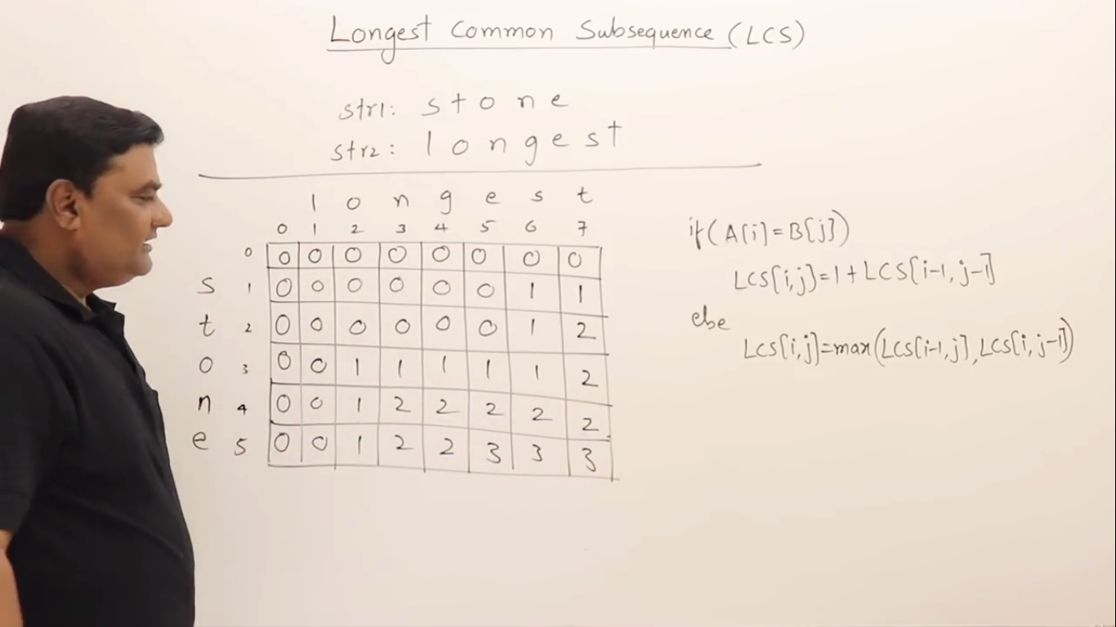
Another Example
Let the two Given Strings are “stone” and “longest”
Solution: Longest Common Subsequence will be “one” of size 3

Slide 83
Matrix Chain Multiplication
Suppose that we want to multiply a sequence of rectangular matrices. In which order should we multiply either A x (BxC) or (AxB) x C ?
Since Matrix multiplication is associative , so parenthenization does not change result.
i.e. A x (BxC) = (AxB) x C
Let A be an n x m matrix, B an m x p matrix. Thus, AB is an n x p matrix.
Computing the product AB takes nmp scalar multiplications and n(m-1)p scalar additions for the standard matrix multiplication algorithm.
More Formally the problem can stated as :
What is the least expensive way to form the product of several matrices, if the naïve matrix multiplication algorithm is used?
Where the number of scalar multiplications defined as cost.

Slide 84
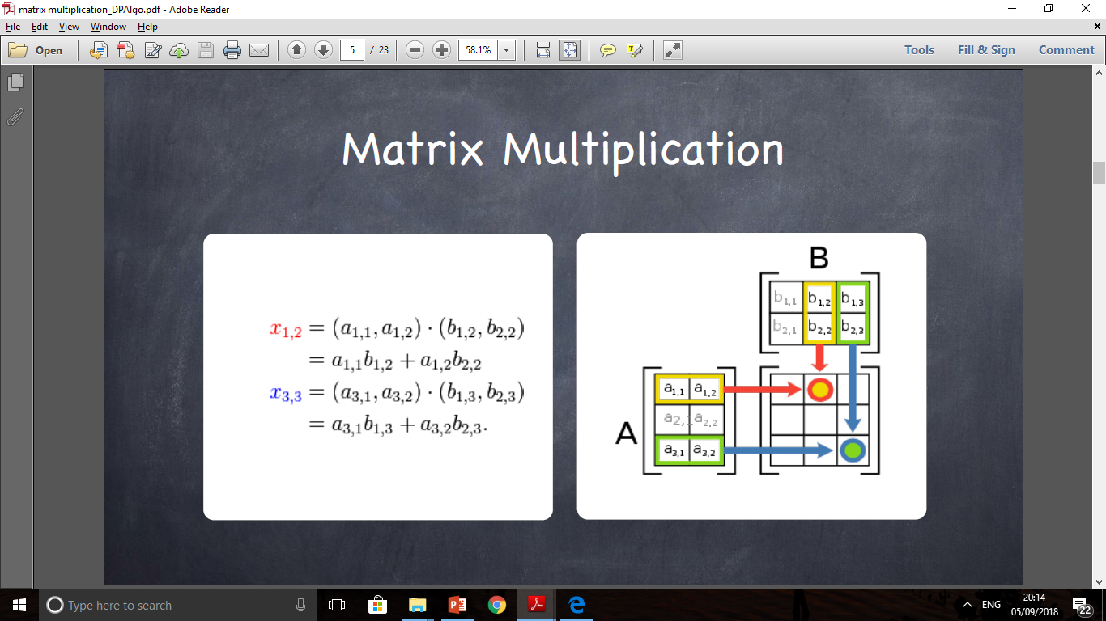
Matrix Multiplication
Let A be an n x m matrix and B an m x p matrix, then the product of A and B is n x p matrix AB whose (i,j)-th entry is
In other words, we multiply the entries of the i-th row of A with the entries of the j-th column of B and add them up.

Slide 85
Why Order Matters?
Suppose we have 4 matrices:
A: 30 x 1
B: 1 x 40
C: 40 x 10
D: 10 x 25
Possible way to multiply them:
((AB)(CD)) : requires 41,200 scalar multiplications
(A((BC)D)) : requires 1400 scalar multiplications

Slide 86
Define Recursive Solution
Define M(i,j) to be the minimum number of multiplications needed to compute A_{i}· A_{i+1} ·… · A_{j}
Goal: Find M(1,n).
Basis: M(i,i) = 0.
Consider all possible ways to split A_{i} through A_{j} into two pieces.
Compare the costs of all these splits:
best case cost for computing the product of the two pieces plus the cost of multiplying the two products.
Take the best one
Recursive call: M(i,j) = min_{k}(M(i,k) + M(k+1,j) + d_{i-1}d_{k}d_{j})

Slide 87
Order for Solving Subproblems
computing the pink square requires the purple ones to the left and below.
So solve the subproblems ( or fill in the table entries) this way:
go along the diagonal
start just above the main diagonal
end in the upper right corner (goal)
M:
1
2
3
4
5
1
0
4
GOAL!
3
2
2
n/a
0
1
3
n/a
n/a
0
4
n/a
n/a
n/a
0
5
n/a
n/a
n/a
n/a
0

Slide 88
Keeping Track of the Order
It's fine to know the cost of the cheapest order, but what is that cheapest order?
Keep another array S and update it when computing the minimum cost in the inner loop.
After M and S have been filled in, then call a recursive algorithm on S to print out the actual order.

Slide 89
Example
M:
1
2
3
4
1:
A is 30x1
1
1
1
S:
1
0
1200
700
1400
2:
B is 1x40
2
3:
C is 40x10
2
n/a
0
400
650
3
4:
D is 10x
25
3
3
n/a
n/a
0
10,000
A x (BCD)
4
n/a
n/a
n/a
0
A x ((BC) x D)
A x ((BxC) x D)
M[1,3]=AxBxC=min(M[1,1]+M[2,3]+30x10, M[1,2]+M[3,3]+30x10

Slide 90
Algorithm
for i := 1 to n do M[i,i] := 0
for d := 1 to n-1 do // diagonals
for i := 1 to n-d do // rows entry on d-th diagonal
j := i + d // column corresponding to row i on d-th diagonal M[i,j] := infinity
for k := i to j-1 to
M[i,j] := min(M[i,j], M[i,k]+M[k+1,j]+d_{i-1}d_{k}d_{j})
if previous line changed value of M[i,j] then S[i,j] := k // To keep track of cheapest split point found so far: between A_{k} and A_{k+1}
endfor
endfor
endfor
Running time O(n3)

Slide 91
Example
Given a chain of four matrices A_{1,} A_{2,} A₃ and A₄ with p₀= 5, p₁= 4, p₂= 6, p₃= 2 and p₄= 7.
Initialization:

Slide 92
Another Example
Given a chain of four matrices A_{1,} A_{2,} A₃ and A₄ with p₀= 5, p₁= 4, p₂= 6, p₃= 2 and p₄= 7.
Solution:

Slide 93
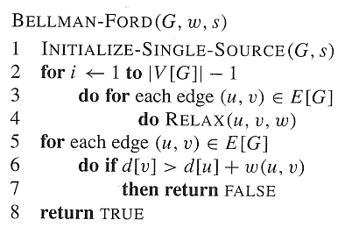
Single Source Shortest-Path (with negative edges):
Bellman-Ford algorithm.
Iteratively relax all edges |V|-1 times
Running time : O(VE)

Slide 94
All-Pairs Shortest Paths
Given an n-vertex directed weighted graph G = (V, E), find a shortest path from vertex i to vertex j for each of the n² vertex pairs (i,j).
Assume no negative weight cycles exist in given graph. When there is a cycle whose length is less than zero (< 0), some shortest paths aren’t finite.
Can run BELLMAN-FORD once from each vertex.
If no negative-weight edges, could run Dijkstra’s algorithm once from each vertex.
Can we do it in better way ?
We’ll see how to do in O(V³) in all cases, with no fancy data structure.

Slide 95
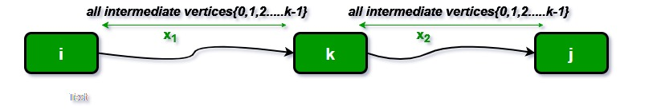
All Pairs Shortest Path – Floyd-Warshall Algorithm
Dynamic programming approach.
Use optimal substructure of shortest paths: Any subpath of a shortest path is a shortest path.
create an n × n matrix of shortest-path distances δ(u, v):
Let d_{ij}^{(k)} –shortest path weight of any path from i to j where all intermediate vertices are from the set {1,2, …, k}.
Ultimately, we would like to know the values of d_{ij}^{(n)}.

Slide 96
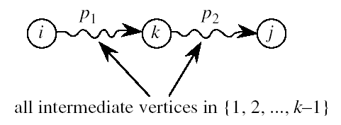
Computing d_{ij}^{(k)}
Base condition: d_{ij}⁽⁰⁾ = ?
d_{ij}⁽⁰⁾ = w_{ij}.
For k>0:
Let p=<v_{i}, . . . , v_{j}> be a shortest path from vertex i to vertex j with all intermediate vertices in {1,2, …, k}.
If k is not an intermediate vertex, then all intermediate vertices are in {1,2, …, k-1}.
If k is an intermediate vertex, then p is composed of 2 shortest subpaths drawn from {1,2, …, k-1}.

Slide 97
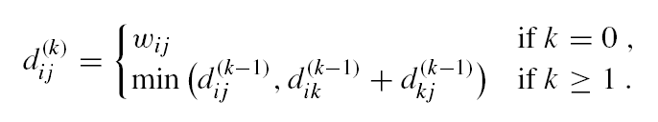
Recursive Formulation for d_{ij}^{(k)}

Slide 98
Example

Slide 99
Step 1

Slide 100
Step 2

Slide 101
Step 3

Slide 102
Step 4

Slide 103
Step 5

Slide 104
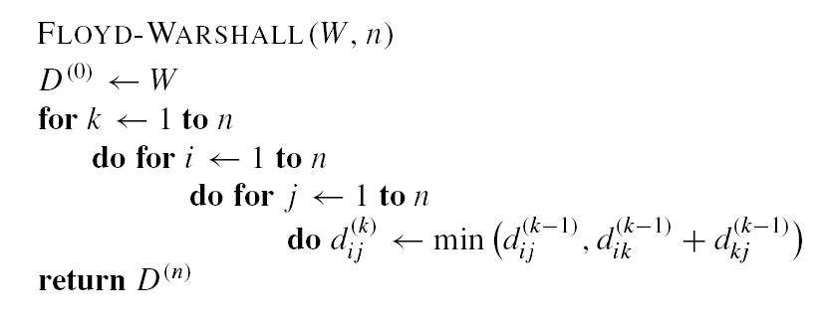

Algorithm
Running time = O(n³).

Slide 105
Another Example
for k = 1 to n
for i = 1 to n
for j = 1 to n
d [i, j] = min (d [i, j],
d [i, k] + d [k, j])
 | 1 | 2 | 3 | 4 | 5
1 | 0 | -1 | 2 | ∞ | ∞
2 | ∞ | 0 | -6 | 2 | ∞
3 | ∞ | ∞ | 0 | 5 | 8
4 | ∞ | ∞ | ∞ | 0 | 1
5 | ∞ | 2 | ∞ | ∞ | 0
-7
1
-2
-1
1
2
8
3
5
8
6
2
3
5
2
1
1
-6
-4
1
-1
4
2
2
4

